Slide 1
SECURE DATA HIDING IN IMAGES USING STEGANOGRAPHY
CAPSTONE PROJECT
Presented By:
Student Name : ARHIT GHOSH
College Name & Department : RCC Institute of Information Technology, AEIE

Slide 2
OUTLINE
Problem Statement
Technology used
Wow factor
End users
Result
Conclusion
Git-hub Link
Future scope

Slide 3
Problem Statement
In these project we will develop a python code which will encrypt a secret message protected by a password, into an image using various module of the python programming language. It will also decrypt the encrypted image to get the secret message using the password.

Slide 4
Technology used
Open-cv(Python library)
Cv2 (Python library)
Tkinter (Python library)
PyCharm (Python IDE)
Windows 11 operating System
8GB RAM

Slide 5
Wow factors
AES Algorithm is used.
Easy to Encrypt and Decrypt the specific images following some simple steps.
GUI that gives a better user experience.

Slide 6
End users
IT officials.
Army officers, Secret Intelligence.

Slide 7
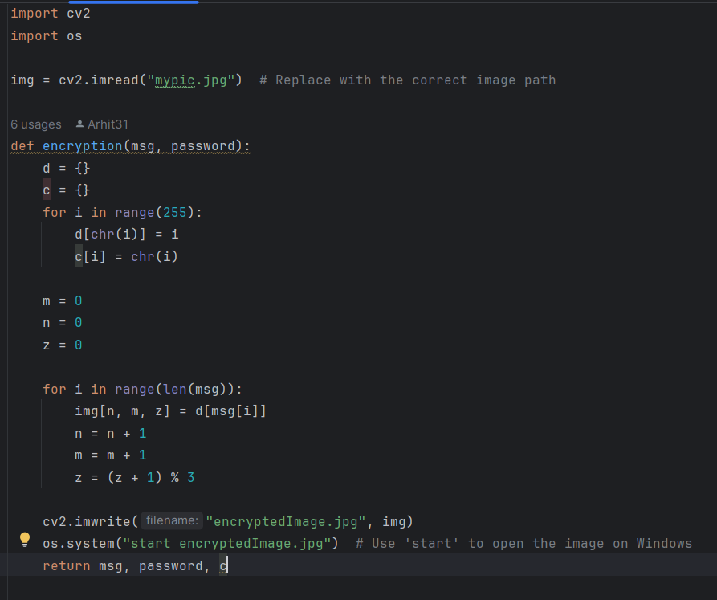
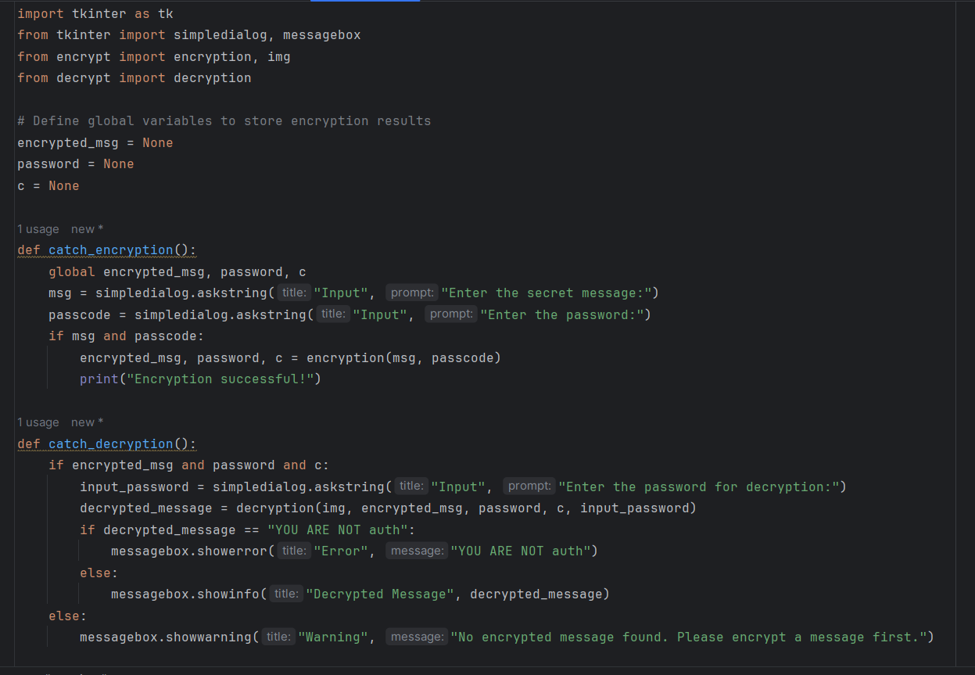
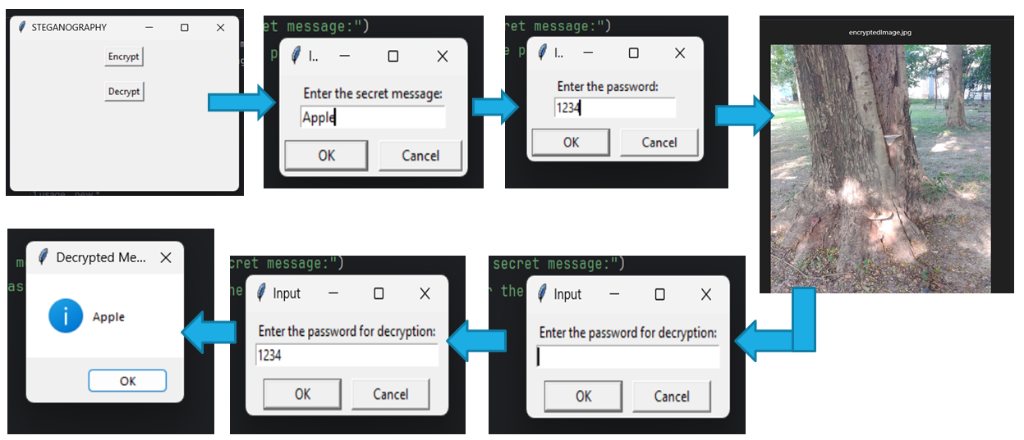
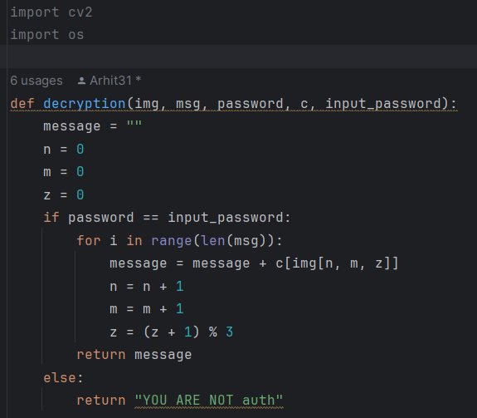
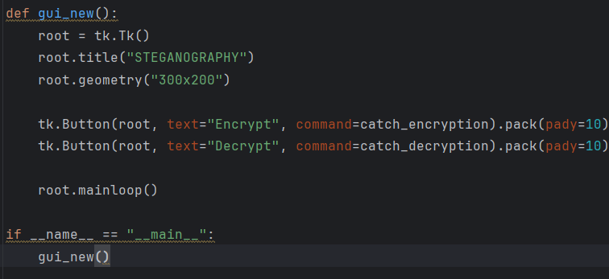
Results

Slide 8
Conclusion
We have successfully created a gui for these python code that demonstrates steganography. In these code we encrypt a text message in a jpg file using a specific password. Then we have successfully derived the same text message from the encrypted image.

Slide 9
GitHub Link
link: https://github.com/Arhit31/Steganography_AICTE_ARHIT_GHOSH.git

Slide 10
Future scope(optional)
These project is a foundation to our knowledge in steganography and cyber-security.
We can develop these project further, maintaining the industry level standards and algorithms to create an app which will encrypt and decrypt text in pictures.

Slide 11
THANK YOU

